Slide 1
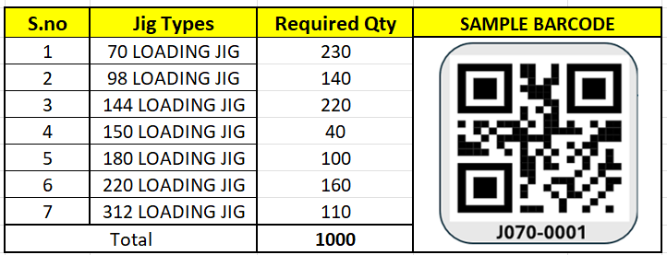

JIG BARCODE REQUIREMENT

